Slide 1
Interrupt processing in assembly language
Aliyeva Ilaha

Slide 2
What are Interrupts?
Interrupts are the events that take place to inform the operating system to stop the current execution of the current process and handle the Interrupt Service Routine (ISR). ISR is responsible to find out which software or hardware caused the interrupt and informing the CPU about it. CPU will service the request and after the completion of the request, CPU resumes the execution of the process which CPU was previously executing. Interrupts can be caused by hardware as well as software.

Slide 3
Hardware Interrupts:
When an external device wants the attention of the operating system to service a certain request, they raise an interrupt which is called hardware interrupts. All the external devices are connected to a single Interrupt Request Line and the Interrupt Request Line is used for the interrupts.

Slide 4
The hardware interrupts are further categorized into two types:
Maskable Interrupts: Hardware interrupts that can be ignored or disabled are called maskable interrupts.
Non-Maskable interrupts: Hardware interrupts that can’t be ignored or disabled are called non-maskable interrupts.

Slide 5
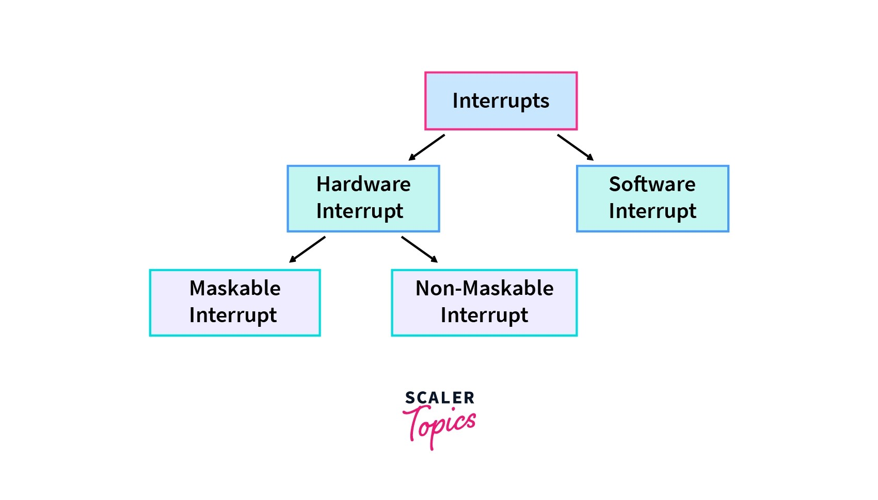

Slide 6
Software Interrupts:
Software interrupts generally take place when there are exceptions in the process or by using special instructions that cause the interrupts. While having the system calls in our system, we generally have the software interrupt. Division by zero throws an exception which caused the software interrupt, whereas while we use fork() system call, fork() also invokes a software interrupt.

Slide 7
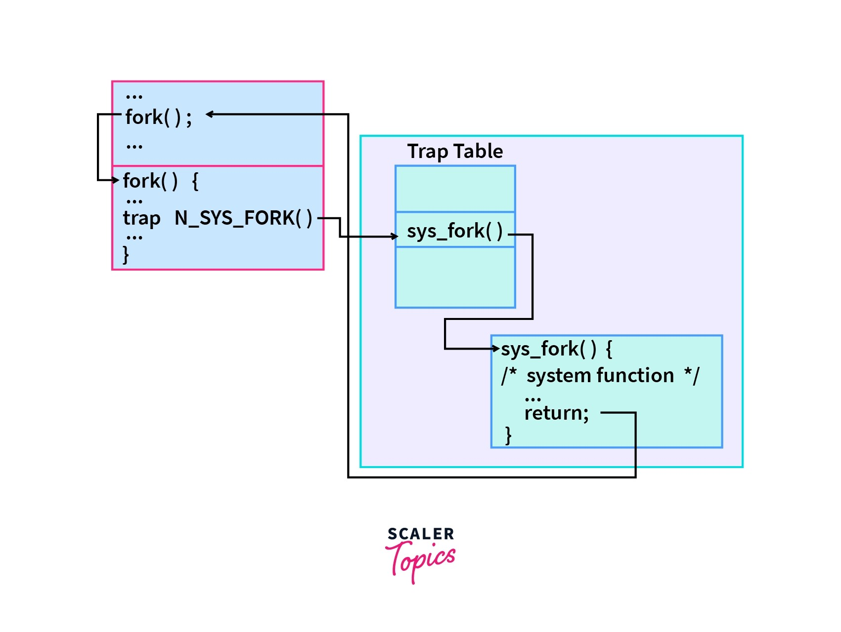

Slide 8
As we can see in the above image when the process executes the fork() system call, an interrupt is generated which is software interrupt and this interrupt will be handled by ISR, once the interrupt request is serviced, the control is passed back to the process which was executing priorly.

Slide 9
Exception
Exceptions, like interrupts, disrupt the normal flow of instructions but occur during program execution that are exceptional and that cannot be handled within the program itself.
Division by zero, execution of an illegal opcode or memory related fault could cause exceptions. Whenever an exception is raised, the CPU temporarily suspends the program it was executing and starts the ISR. ISR will contain what to do with the exception. It may correct the problem or if it is not possible it may abort the program gracefully by printing a suitable error message. Although a specific instruction does not cause an exception, an exception will always be caused by an instruction. For example, the division by zero error can only occur during the execution of the division instruction.

Slide 10
CPU Response to Interrupts
When the interrupt occurs, the CPU completes the execution of ongoing instruction and handles the ISR. But once the interrupt is resolved, the CPU continues to execute from where an execution was stopped prior to the interrupt.

Slide 11
Context Switching
Context Switching is the process where the state of the current process is saved and stored, while another process is brought for execution. Once the execution of the new process completes, the CPU restores the state of the old process and continues the execution from where the execution of the process was left.

Slide 12
So following steps are involved while handling the interrupts:
The First step involved in handling the interrupt is to check the priority of the interrupt.
If the priority is low compared to the current process under execution, then interrupt is saved in the memory.
If the priority is high compared to the current process under execution, CPU saves the context of the current process.
CPU loads the new process which invoked the interrupt and executes that.
On completion of the requested service, CPU loads the process which was under execution prior to the interrupt and resumes the execution from where the execution was interrupted.

Slide 13
Sending Signals -- kill(), raise()
There are two common functions used to send signals
int kill(int pid, int signal) - a system call that send a signal to a process, pid. If pid is greater than 0, kill() sends its signal to the process whose ID is equal to pid.
If pid is equal to 0, kill() sends its signal to all processes whose process group ID is equal to that of the sender, except for those that the sender does not have appropriate privileges to send a signal to.
If pid is -1, kill() returns -1.
int raise(int sig) sends the signal sig to the executing program. raise() actually uses kill() to send the signal to the executing program:
kill(getpid(), sig);
There is also a UNIX command called kill that can be used to send signals from the command line - see man pages.

Slide 14
Raise with Kill Example Program
#include<stdio.h> #include <unistd.h> #include<signal.h> void sig_handler(int signum){ printf("Inside handler function\n"); } int main(){ pid_t pid; signal(SIGUSR1,sig_handler); // Register signal handler printf("Inside main function\n"); pid=getpid(); //Process ID of itself kill(pid,SIGUSR1); // Send SIGUSR1 to itself printf("Inside main function\n"); return 0; }

Slide 15
Standart signals
SIGHUP - hang-up the process. The SIGHUP signal is used to report disconnection of the user’s terminal, possibly because a remote connection is lost or hangs up.
SIGINT- interrupt the process. When the user types the INTR character (normally Ctrl + C) the SIGINT signal is sent.
SIGQUIT- illegal instruction. When an attempt is made to execute garbage or privileged instruction, the SIGILL signal is generated. Also, SIGILL can be generated when the stack overflows, or when the system has trouble running a signal handler.
SIGTRAP Abort. The SIGABRT signal is generated when abort() function is called. This signal indicates an error that is detected by the program itself and reported by the abort() function call.

Slide 16


